Slide 1
Types of Decision Trees
ID3 --- Iterative Dichotomiser 3 -- BTREE
Entropy
E—parent
E—chind
Information gain = E(P)-E© == .2
C4.5 --- C5.0 --- GAIN RATIO------
CHAID ---- CHI SQAURE TEST --- MULTIWAY TREE
CART --
LSD -- DECREASING VARIANCE [Regression]
GINI Impurity [Clasification ]

Slide 2
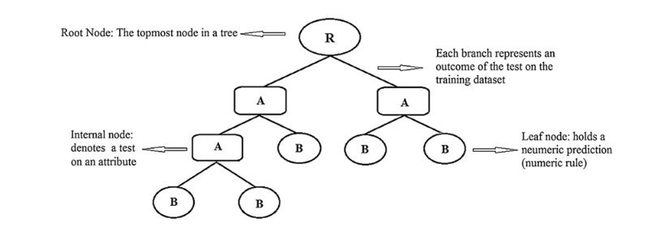
PRE PRUNING vs POST PRUNING
min bucket and min split
EXPAINABILTIY of a model
6 SIGMA -- industry standard

Slide 3
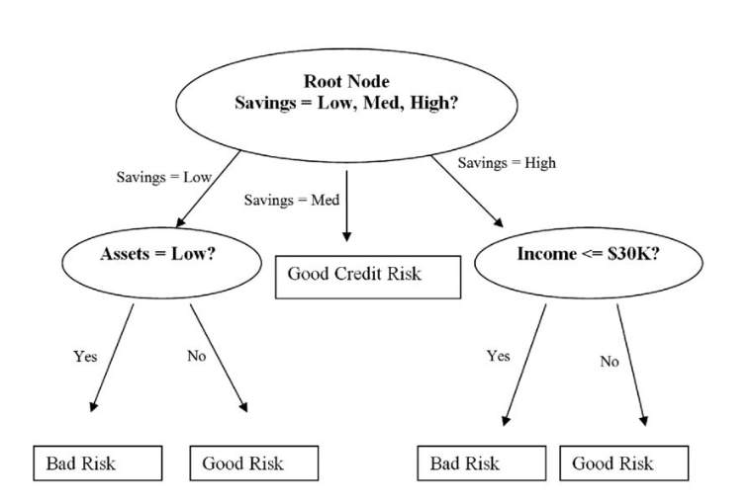

Slide 4
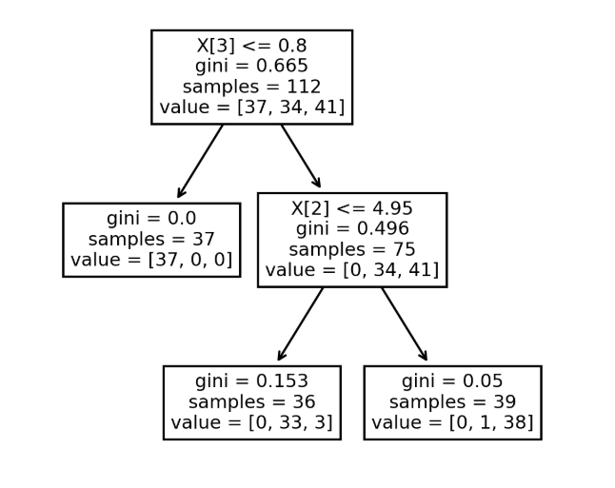
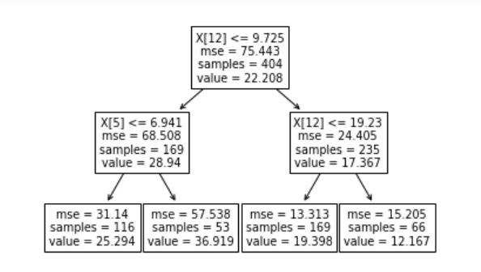
Classification tree
Regression tree

Slide 5
